Slide 1
GameCo Marketing Presentation
Alex Lam

Slide 2
Hypothesis
Question
GameCo’s business strategies going forward should be based around the needs of each region
What is popular in each region?

Slide 3
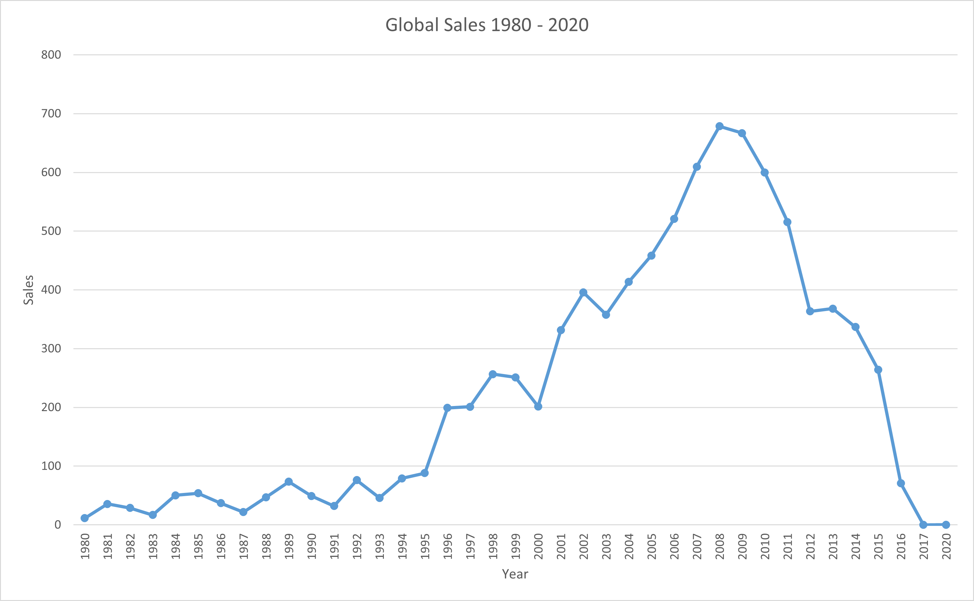
Trend in Global Sales
Global sales have seen a rise of popularity from 1980 to 2010 with regularly occurring dips in sales
2013 onward has less data collected for all publishers, which explains the significant sales dip in all the data
There should be more data gathered for this time period for a clearer picture, but the data available is shows a story of genres and trends

Slide 4
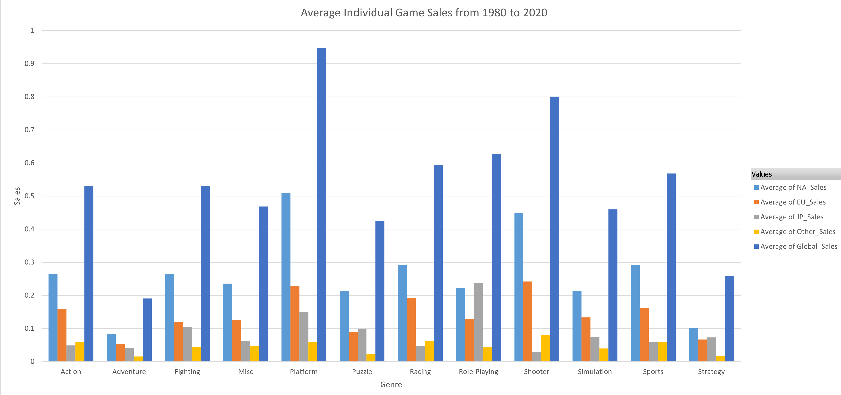
Initial Analysis on Genres
Quantity of sales is in the millions, i.e. 0.1 units sold means 100,000 units sold
Average sales per game are being sold to get a better idea on how much an average product will sell
Top globally selling genres: Platform, Shooter, Role-Playing, Racing, Sports

Slide 5
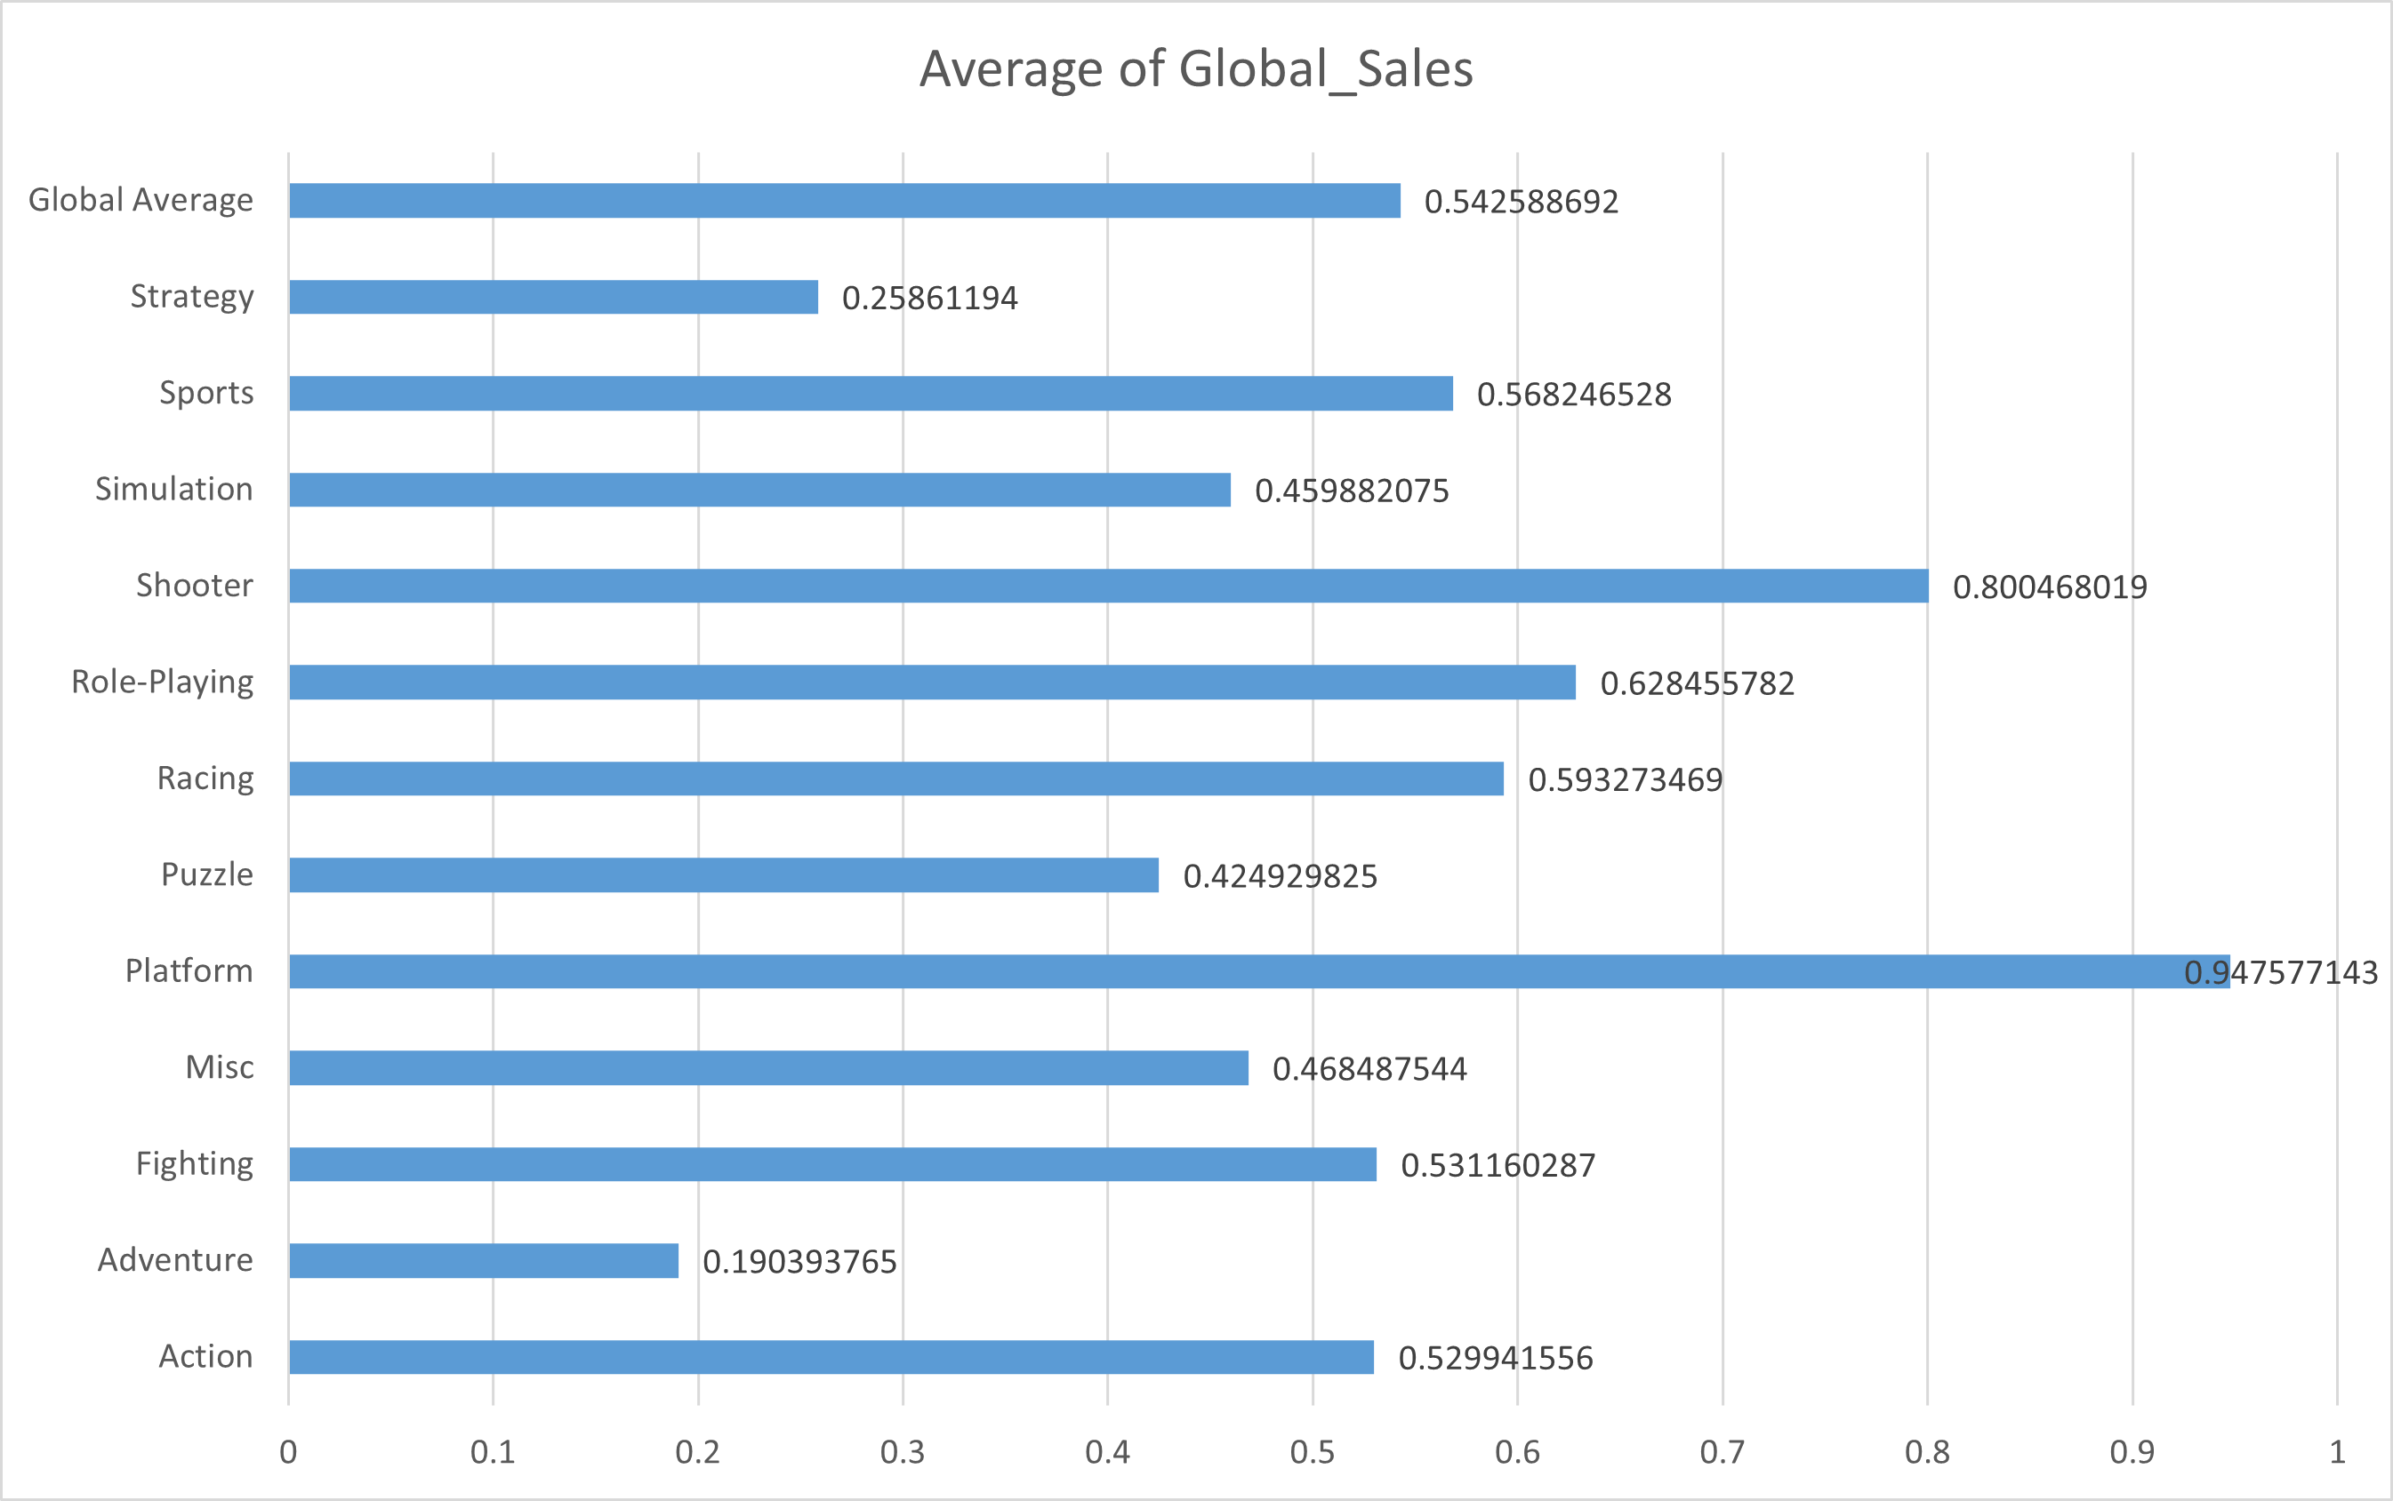
Top Five Genre Analysis
Platform, Shooter, Role-Playing, Racing, and Sports games sell more than the 0.54 global average
Platform genre’s individual games seem to sell the most on average, but this is due to a few outliers

Slide 6
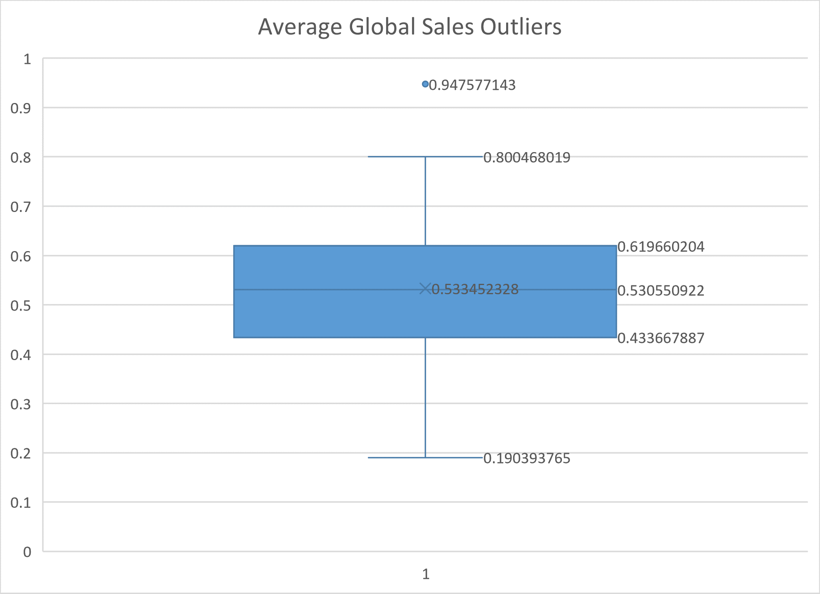
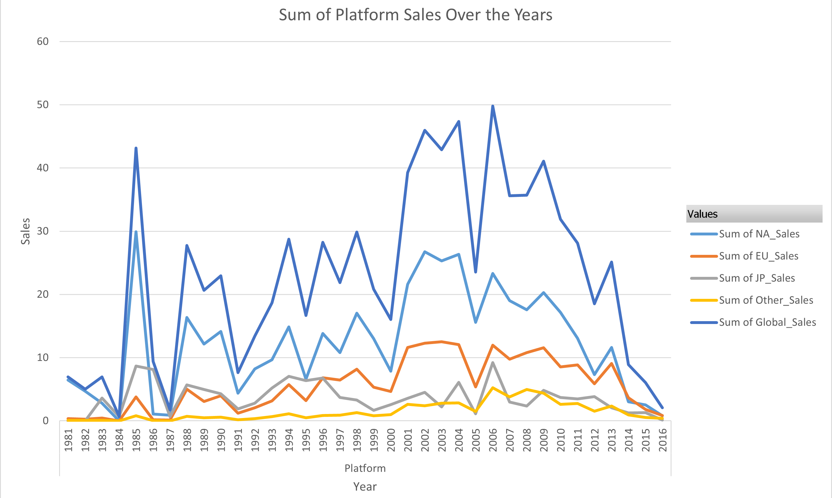
Platform Genre Analysis
Platform’s average sales are 0.94 well above 0.8, the maximum value of the data set, which is not an outlier
Sales for the genre have never been consistent
Spikes are due to a year or two of success for the genre
GameCo should look towards the other genres going forward

Slide 7
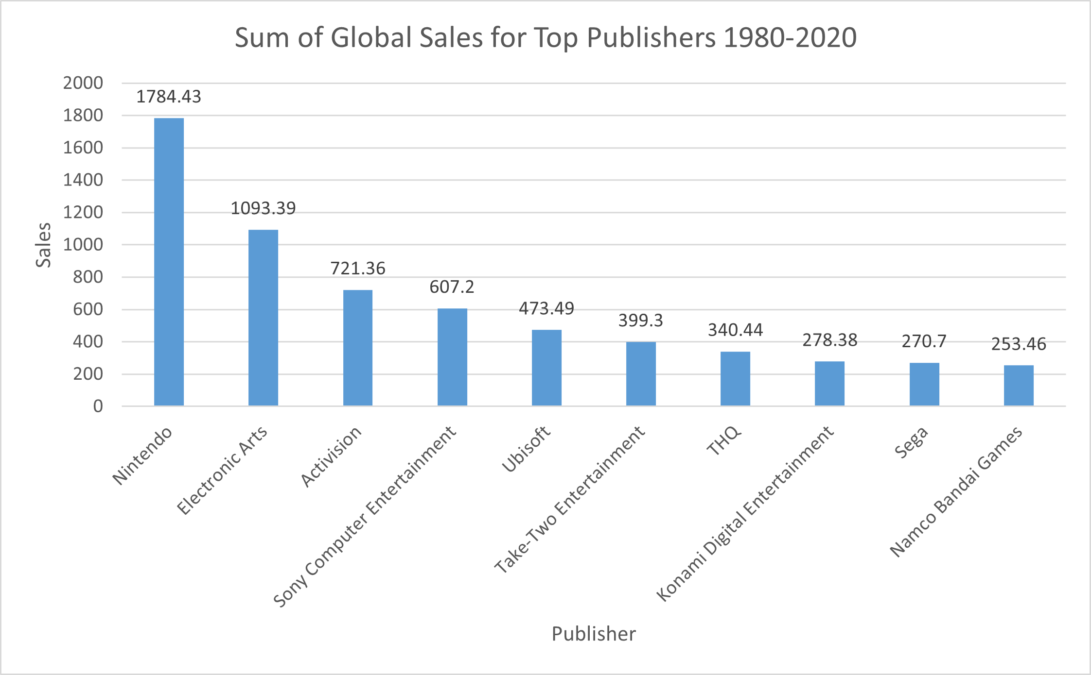
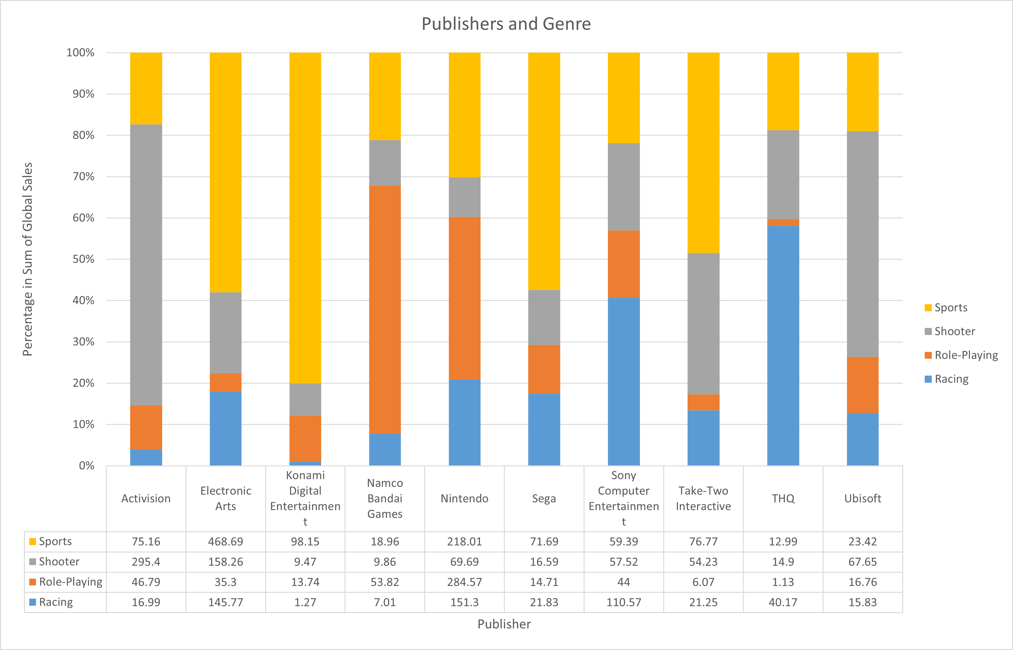
Top Selling Publishers and Popular Genres
Top ten selling publishers all have diversity in products
Publishers have specialties in certain genres, but at least have a foothold in any of the most popular genres

Slide 8
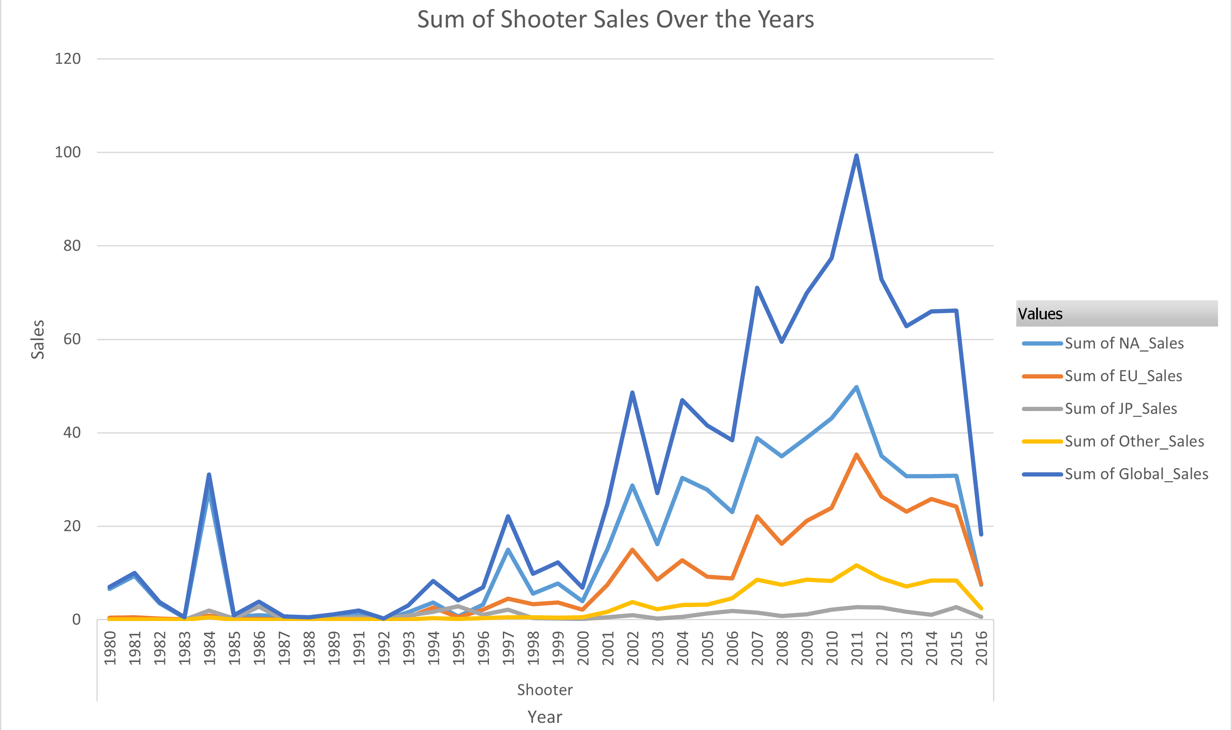
Shooter Genre Analysis
All regions except Japan show a strong interest in the genre
With North American and Europe, historically the genre takes dip, but then increases, i.e. a dip occurred 2008, but sales increased by 2010
NA sales increased by 23%
EU sales increased by 47%
North America is the biggest market, but Europe is growing rapidly

Slide 9
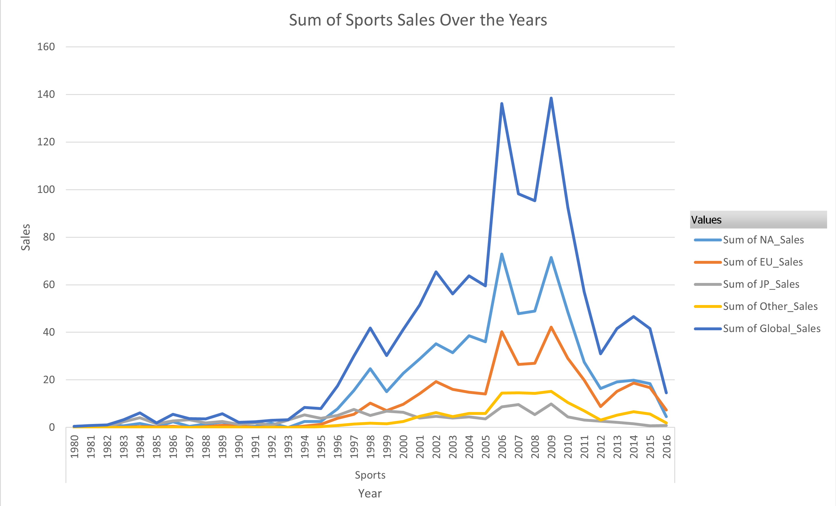
Sports Genre Analysis
Comparable to Shooter genre, where it has popularity in North America and Europe and does not have strong Japanese sales
Sales have overall increased but the numbers are volatile
Sales are the highest globally

Slide 10
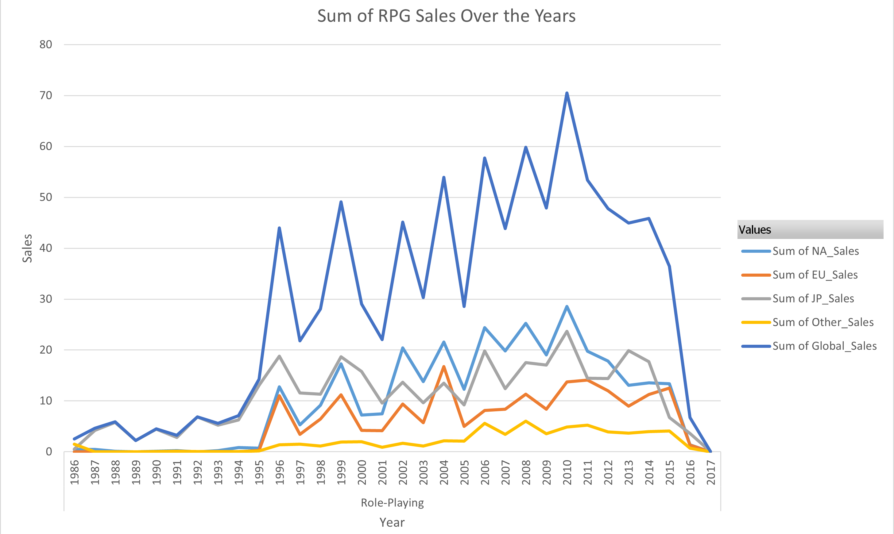
Role-Playing Genre Analysis
Genre sees success in North America and Japan, but European sales historically have not been very good
Global the sales are volatile, but per North America and Japan the dips are less extreme
Despite the dips in sales regionally sales are steadily increasing
NA sales increased by 297% from 2000 to 2010
JP sales increased by 50% from 2000 to 2010
RPG sales must be looked at in the long term

Slide 11
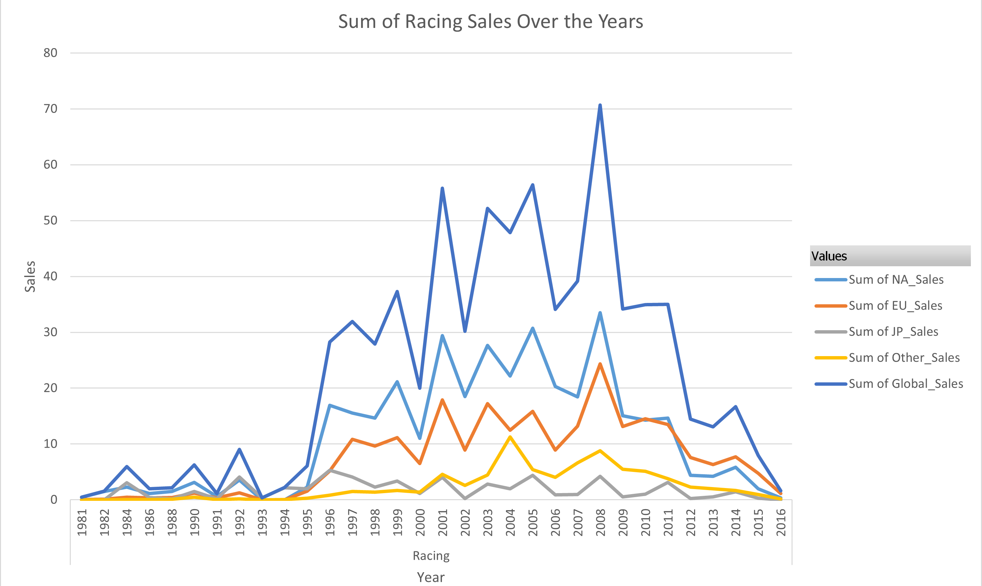
Racing Genre Analysis
Racing sales are very volatile globally
Compared to RPGs, racing sales do not have consistent trends
Racing had high average sales per individual title due to outliers

Slide 12
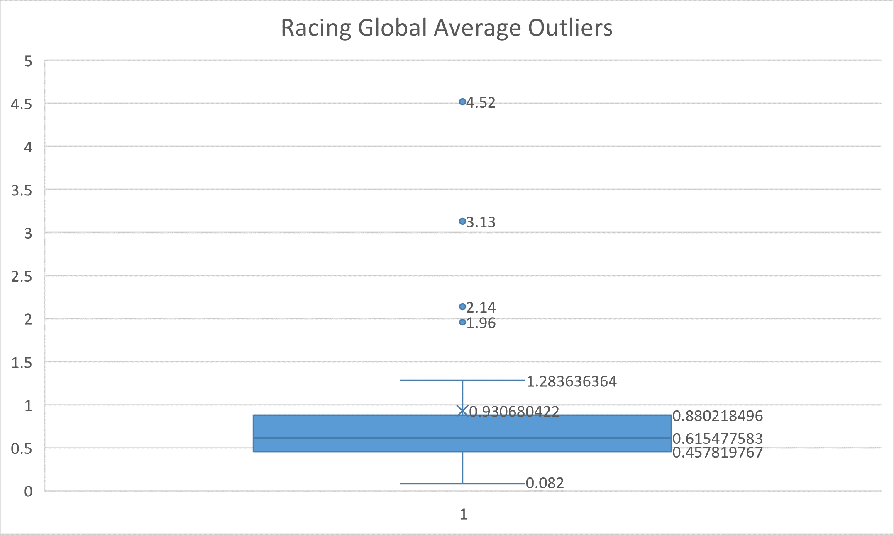
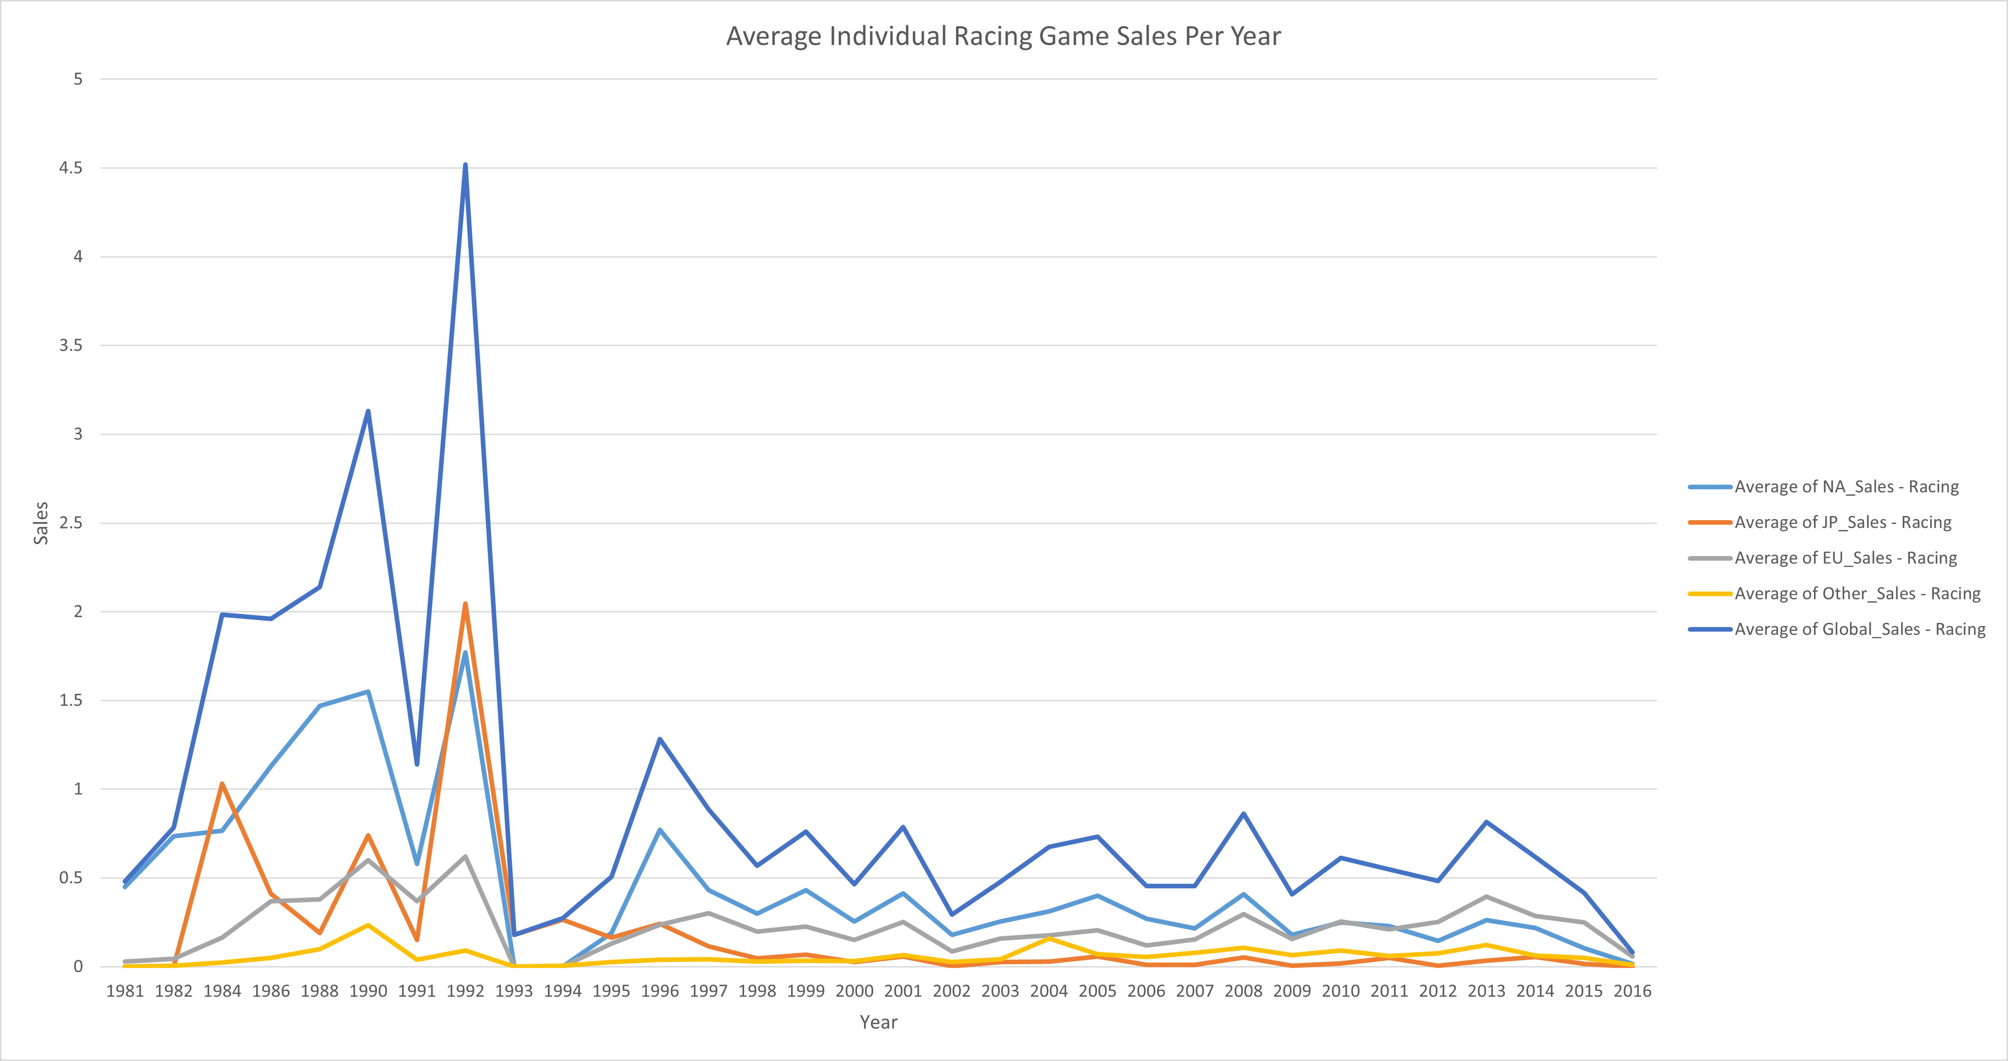
Racing has had years where it has been extremely success yet sales for the following year have a huge drop
Several years’ sales totals are shown to be outliers, such as 1.96, 2.14, 3.13, and 4.52
Average global sales from 1981 to 2016 are shown to be 0.59
GameCo should look to the other three genres for their future business prospects

Slide 13
Actions & Recommendations Going Forward
North America is the most diverse market where the Shooter, Sports, and Role-Playing genres are steadily growing
European markets should focus on the Shooter and Sports genre
Japan has a specific preference with Role-Playing games
Further data should be collected in order to see how these three genres perform and a reevaluation in strategy should follow

